Slide 1
Investors Presentation
March 2016
www.starcomsystems.com

Slide 2
Important Notice
The information contained in these slides and to be communicated during the presentation of these slides, including the talks given by the presenters, any question and answer session and any documents or other materials distributed at or in connection with the presentation (together the "Presentation") is confidential and is being supplied in the United Kingdom only to (i) persons who have professional experience in matters relating to investments (being "investment professionals" within the meaning of Article 19 of the Financial Services and Markets Act 2000 (Financial Promotion) Order 2005 (the "FPO")) or (ii) persons falling within Article 49(2) ("high net worth companies, unincorporated associations etc") of the FPO or (iii) persons who are otherwise permitted by law to receive it (all such persons being "relevant persons"). The information contained in the Presentation is not intended to be viewed by, passed on or distributed (directly or indirectly) to, any other category of persons. Any investment or investment activity to which the Presentation relates is available only to relevant persons and will be engaged in only with relevant persons. This Presentation must not be acted or relied upon by persons who are not relevant persons.
No undertaking, representation, warranty or other assurance is given, and none should be implied, as to, and no reliance should be placed on, the accuracy, completeness or fairness of the information or opinions contained in the Presentation. The information contained in the Presentation is subject to completion, alteration and verification. Save in the case of fraud, no liability is or will be accepted for such information by Starcom PLC (the “Company”) or Northland Capital Partners Limited (“Northland”) or any of their respective directors, officers, employees, agents or advisers or any other person.
Information contained in the Presentation may not be distributed, published or reproduced in whole or in part or disclosed by recipients to any other person. The distribution of any document provided at or in connection with the Presentation in jurisdictions other than the United Kingdom may be restricted by law and therefore persons into whose possession any such documents may come should inform themselves about and observe any such restrictions. In particular, information contained within the Presentation is not for distribution in or into the United States, Canada, Australia, the Republic of Ireland, Japan or South Africa. Any failure to comply with these restrictions may constitute a violation of the securities law of such jurisdictions.
The information contained in the Presentation does not constitute a prospectus or admission document and does not constitute, or form part of, any offer of, or invitation to apply for, securities nor shall it, or the fact of its distribution, form the basis of or be relied upon in connection with any contract or commitment to acquire any securities. Recipients of the information contained within the Presentation who are considering acquiring shares in the Company are reminded that any such purchase or subscription must be made only on the basis of the information contained on the public record of the Company, which may be different from the information contained in the Presentation. The Presentation should not be considered a recommendation by the Company or Northland or any of their respective directors, officers, employees, agents or advisers in connection with any purchase of or subscription for securities of the Company.
Recipients of the information contained in the Presentation should note that Northland, which is regulated in the United Kingdom by the Financial Services Authority, is acting exclusively for the Company and no-one else in relation to the proposals set out in the Presentation and will not be responsible to any other person for providing the protections afforded to customers of Northland or for providing advice to any other person in relation to the proposals set out in the Presentation.
The information contained in the Presentation is confidential and may include price sensitive information and accordingly attendees at the Presentation should not deal in any securities of the Company before the information is made public. In agreeing to attend the Presentation, you have agreed to be treated as an "insider" in relation to the information to be disclosed at the Presentation.

Slide 3


  Developing sophisticated, adaptable telematics solutions for remote monitoring and tracking of people and assets globally
Notes:
Starcom is an innovation and technology worldwide leader, develops a wide range of sophisticated telematics solutions

Slide 4




Company Highlights
ESTABLISHED GROUP
TECHNOLOGY PARTNER
15+ years’ experience.
Traded on the AIM Market (STAR).
GLOBAL PRESENCE
Assa Abloy (world’s largest lock manufacturer)
Over 100 distributors
Over 50 countries
Over 50 logistics partners
ISO-9002 CERTIFIED
Uses GPS/GLONASS and latest CELLULAR TECHNOLOGIES
Incl. 2G, 3G, and 4G-LTE
Field proven products with
Global certification (TUV, FCC, E-24, and EMC)

Slide 5
Business Model
Starcom sells its products to distributors in over 50 countries
All products use the same core technology and share a similar business model
End users include commercial fleet vehicles, inland and public transportation operators, shipping companies, corporates and private customers
Revenues generated from the initial sale and thereafter by monthly subscriptions to Starcom Online producing recurring income
Units manufactured in Taiwan by sub-contractor
No direct relationship between Starcom and end-user

Slide 6
FY 2015 Financial Highlights
Operating loss was reduced by 45% - US$1.6m in 2015, compared to US$2.9m in 2014.
Net loss was reduced by 36% - US$1.8m in 2015, compared to US$2.8m in 2014.
Net Cash used in operating activities for the year was reduced by 86% - US$0.4m in 2015, compared to US$2.9m in 2014.
Growth of 2.5% in revenue – US$5.1m in 2015, compared to US$5m in 2014.
Cost cutting and enhanced efficiency in 2015 lowered general and administrative expenses by US$1.1m. This reflects reduced the general and administrative expenses by 27%.

Slide 7


Starcom Product Line

Slide 8












Starcom Product Line - Covering Every Aspect of Tracking
Watchlock
Reporting Padlock
TETIS
Container Monitoring
Online and Mobile Application
Management Tools
Kylos
Compact personal tracking device
Asset protection and management
Helios
Vehicle and Motorbike Tracking

Slide 9
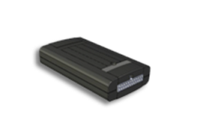
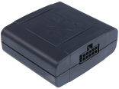

The Helios Family
Brochure
Movie
Advanced
Hybrid
TT – Track & Trace
AVL (Automatic Vehicle Location) and Fleet Management: Advanced unit supporting fleets with real time track and trace and complete fleet management telematics
Vehicle location unit with full fleet management, combining cellular connectivity and Iridium modem
Enables constant global communication
Cost-effective AVL unit for vehicles and motorbikes
Includes real-time theft and accident alert with basic fleet management functions, tow detection
Extremely low power consumption

Slide 10
Helios - Vehicle and Motorbike Tracking
Potential Benefits
Lowering costs – route optimization can lead to fuel and personnel savings
Operational efficiency – fleet managers keep track of assets in the field
Emergency alerts – automatic collision detection and reporting
Theft recovery – multiple options to alert authorities and others
Multiple connectivity options – enables use in areas with poor communications
Flexibility and customization – using a sophisticated events generator
Over 200 features – fuel consumption tracking, off-line communication option for reduced communication costs, built-in accelerometer, OTA (over the air), custom events generator, upgrade capabilities, etc.

Slide 11
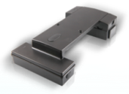
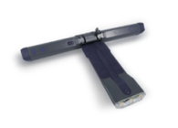
The TETIS Family
Brochure
Movie
Tetis for Dry Containers
Tetis R for Reefer Containers
Tetis R Hybrid
Monitors location, impact, container loss and theft
Easy installation on container's door hinge
Cellular engine (3G) and GPS/GLONASS
Accelerometer, temperature and light detectors
Detects deviation from temperature and humidity ranges – in real time
Monitors deviation route, accident, damage, attempted break-in and unauthorized container door opening
Satellite (Iridium) and cellular (3G) HYBRID monitoring solution based on the Tetis R for dry & refrigerated containers

Slide 12

TETIS - Container Monitoring
Full real time control of cargo’s exact location, status from loading until final destination
Major Growth Drivers:
Over 80% of international trade goods are carried by sea*
More than 11 million cargo containers enter U.S. seaports annually**
North America and Europe: most advanced, growing markets *
Cargo theft is estimated in up to U$30 billion annual cost***
Cellular/satellite tracking systems expected to grow by 49.1% per year,
reaching 1M units by 2017*
*Source: Berg Insight
**Source: US Customs and Border Protection ***Source: FBI
Notes:
How many containers are stolen in the US?
MILLIONS OF DOLLARS LOST FROM STOLEN CONTAINERS

Slide 13
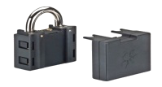
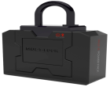
The Watchlock® Family
Brochure
Movie
Watchlock® Economy
Watchlock® Advance
Award-winning WatchLock® combines GPS/Glonass and cellular technology with high security locking of Mul-T-Lock padlock
User notification: Location, Access and battery replacement status
Applicable for remote and traveling assets.
Fully autonomous, real-time monitoring system with full access control capabilities
Access control – remote authorization of each use
External power supply

Slide 14
Watchlock®- The Reporting Padlock
High security padlock with built-in GPS & Cellular technologies
World class innovation
Developed with Assa Abloy (world's largest lock manufacturer)
Combines high security padlock with electronic alarm system
Ideal for mobile and static applications assets
Winner of Physical Security Innovation Product at the 2012 IFSEC Security
Benefits
High security padlock from Mul-T-Lock: a unique patented key duplication control
Personal control LBS notification upon leaving or entering a predefined area
Consistent reporting - Complete information about opening and closing hours and place.

Slide 15
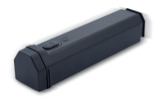

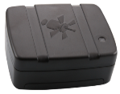
The Kylos Family
Brochure
Kylos Forever
Kylos Compact
Kylos
Long-lasting device for monitoring remote assets/equipment up to 3 years)
Daily notifications
Real time reports about irregular events
Small - fits into the palm of your hand
Highly adaptable - attached to assets, worn by people and pets, hidden in items
Suitable for longer periods of time without needing battery recharge
Keeps track of pallet on long routes
Allows users to monitor large items, position of fragile goods and cargo requiring special handling
No need for installation

Slide 16









Kylos Asset Management
Real time personal tracker and assets monitoring
Small, powerful sensors
Pinpoints exact position of merchandise/personal items, anytime - for management & protection
Alerts in case merchandise enters/leaves predefined area
Alerts in case one’s child or pet wanders into or leaves specific zone/area pre-set as safe/unsafe
Light sensor alerts in case warehouse is being breached before intruder reaches merchandise
Light sensor alerts in case goods are left in container or truck
Temperature sensor alerts in case of fire, before it reaches the goods
Built-in accelerometer alerts in case goods fall
or are damaged due to incorrect handling
Built in panic button activates an emergency call to a pre-set number (e.g. if a child is in distress and is unable to dial). Pressing the panic button would prompt a call to the parent

Slide 17
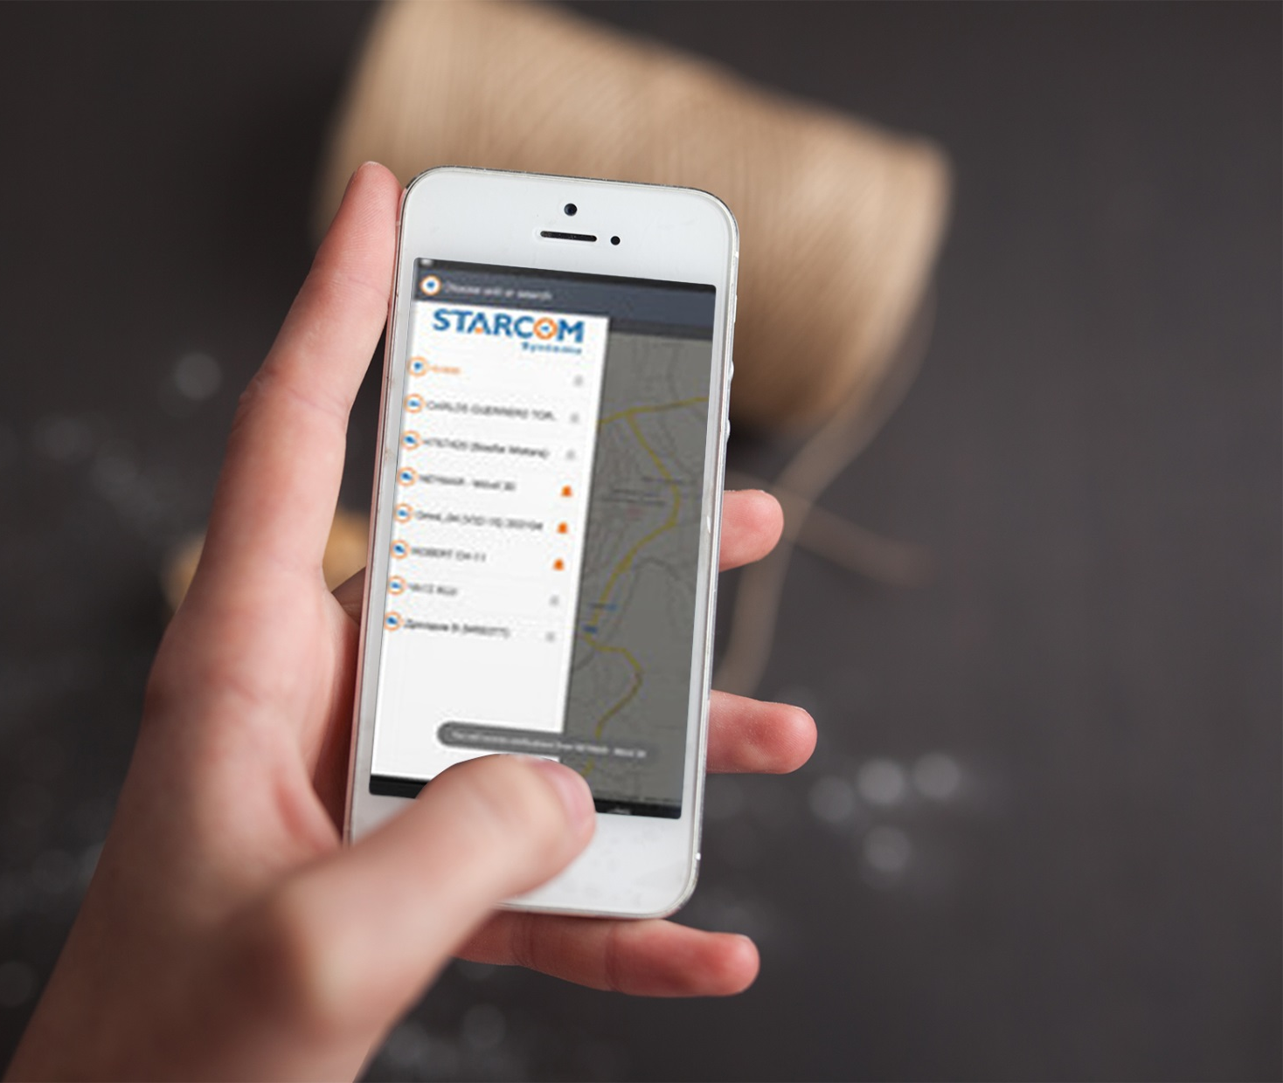
Starcom Systems Management Tools

Slide 18


White Label Real-time Software
User-friendly Device Management tools for immediate response:
Control Center application
Cloud application
Mobile application
Cloud and Mobile apps Benefits:
On-line access anywhere, any time
Real-time data, on vehicles/freight/goods/personal/pets
Ability to capture valuable data for future planning
Automatically generates reports on a daily/weekly/monthly basis, with specified data
Fully customizable to user needs
All-in-one solutions for entire range of devices
Control center for distributors:
Multi-languages support
Customizable chain of notifications in the event
of an emergency

Slide 19

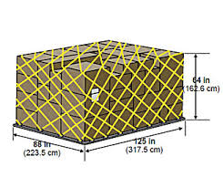

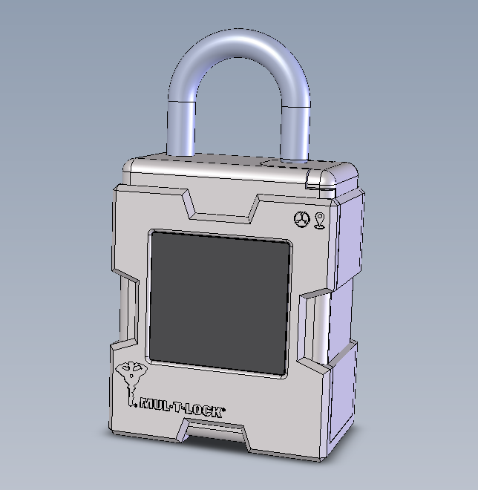
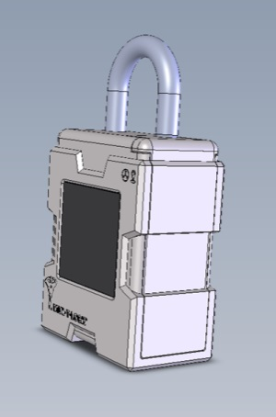
New Products being launched in 2016:
Kylos Air – A tracking and monitoring system aimed at the rapidly growing air cargo market.
Intended to launch in Q2.
Watchlock Pro – Our updated version of the award winning reporting lock (Winner of Physical Security Innovation Product at the 2012 IFSEC Security). Latest version includes added functions.
Soft launch intended to start in Q2, and advanced
Remote opening will be introduced in Q3.

Slide 20
New Horizons for 2016
Q4 2015 – Starcom has entered into a supply and support agreement with Pinnacle Systems Limited. The value of the contract over the three year period (including service fees) based on the quantities specified in the contract is US$5.5m.
Starcom Systems North America - Starcom is opening an office in Miami with a view to penetrating the North American market and hopes to begin to see the benefits during 2016.

Slide 21
Appendix
Notes:
Starcom is an innovation and technology worldwide leader, develops a wide range of sophisticated telematics solutions

Slide 22
Financial Highlights
US$ ‘000 | 2015 | 2014
Revenues | 5,131 | 5,005
Gross Margin | 40% | 50%
Operating Loss | 1,560 | 2,906

Slide 23
P&L: 2015 VS. 2014
US $ ‘000 | 2015 | 2014
Revenues
Total Revenues | 5,131 | 5,005
Total Cost of Goods | -3,065 | -2,499 | -22.6%
Gross Margin | 2,066 | 2,506 | -17.6%
Operating Expenses
General & Administrative | -2,906 | -4,037 | 28.0%
R&D and Testing | -115 | -253 | 54.4%
S&M | -615 | -901 | 31.8%
Other | 10 | -221 | 104.5%
Total Operating Expenses | -3,626 | -5,412 | 33.0%
Operating Profit / Loss | -1,560 | -2,906 | 46.3%
EBITDA | -1,226 | -2,445 | 49.8%
Exchange rate differentials | -11
Bank Fees and loans from banks | -188 | -145 | -29.5%
Total Finance | -199 | -145 | -36.9%
 | -1,759 | -3,051 | 42.4%
Tax and other |  | 233
Net Profit / Loss | -1,759 | -2,818 | 37.6%

Slide 24
EBITDA and Net Cash: 2015 VS. 2014
US $ ‘000 | 2015 | 2014
Net Cash used in operating | -393 | -2,878
Net Cash used in investing | -562 | -869
Net Cash Provided by Financing | 942 | 3,801
EBITDA | -1,226 | -2,445

Slide 25
Balance Sheet: 2015 VS. 2014
Assets | 2015 | 2014
Current Asset
Cash and Cash Equivalents | 90 | 103
Customers / Accounts | 1,343 | 1,943
Accounts receivable and debit balance | 44 | 114
Short Term Deposit | 63 | 101
Inventory | 2,202 | 3,382
Income Tax Authorities |  | 56
 | 3,742 | 5,699
Non Current Asset
Intangible Assets | 2,611 | 2,312
Fixed Assets | 359 | 395
Income Tax Authorities | 67
 | 3,037 | 2,707
Toatal Assets | 6,779 | 8,406
Liabilities | 2015 | 2014
Current Liabilities
Related parties | -347 | -374
Short term bank credit | -270 | -309
Short term loans and current maturities of long-term loans from banks | -316 | -331
Convertible debenture | -91
Trade payables | -1,330 | -2,167
Other accounts payable | -179 | -159
 | -2,533 | -3,340
Long Term Liabilities
Related parties | -153
Bank Loan | -570 | -698
Notes payable | -26
 | -749 | -698
Equity | -3,497 | -4,368
Total Liabilities | -6,779 | -8,406

Slide 26
Thank You

